Slide 1
Introduction to Computer Networks 22CS008
Channelization Protocols
Lecture15-16 (Theory)
Dr. Htet Ne Oo
Department of Computer Science and Engineering,
Chitkara University, Punjab

Slide 2
Index
,
Concept Multiple Access Resolution
Control Access
Reservation Polling Token Passing
Channelization
FDMA
TDMA
CDMA

Slide 3
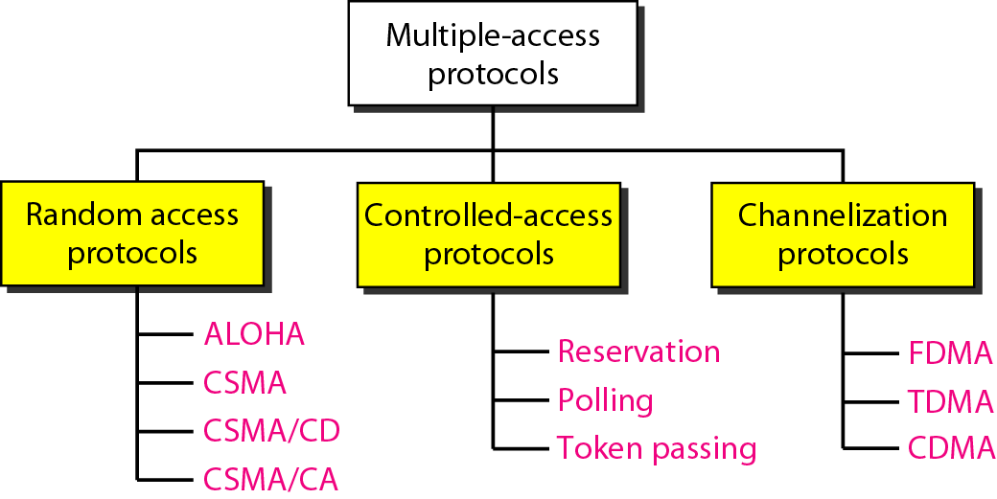

Slide 4
CONTROLLED ACCESS
In controlled access, the stations consult one another to find which station has the right to send.
A station cannot send unless it has been authorized by other stations.
There are three popular controlled-access methods.

Slide 5
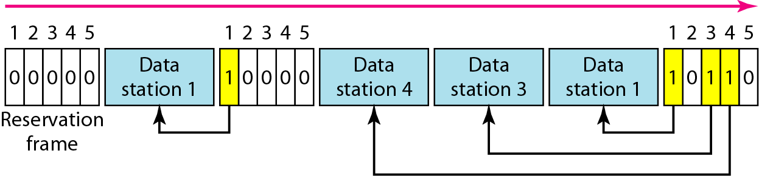
Reservation access method
Figure 1 Reservation access method

Slide 6
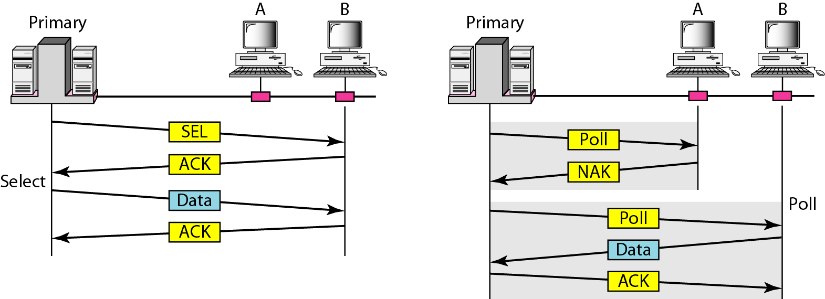
Select and poll functions in polling
access method
Figure 2 Select and poll functions in polling access method

Slide 7
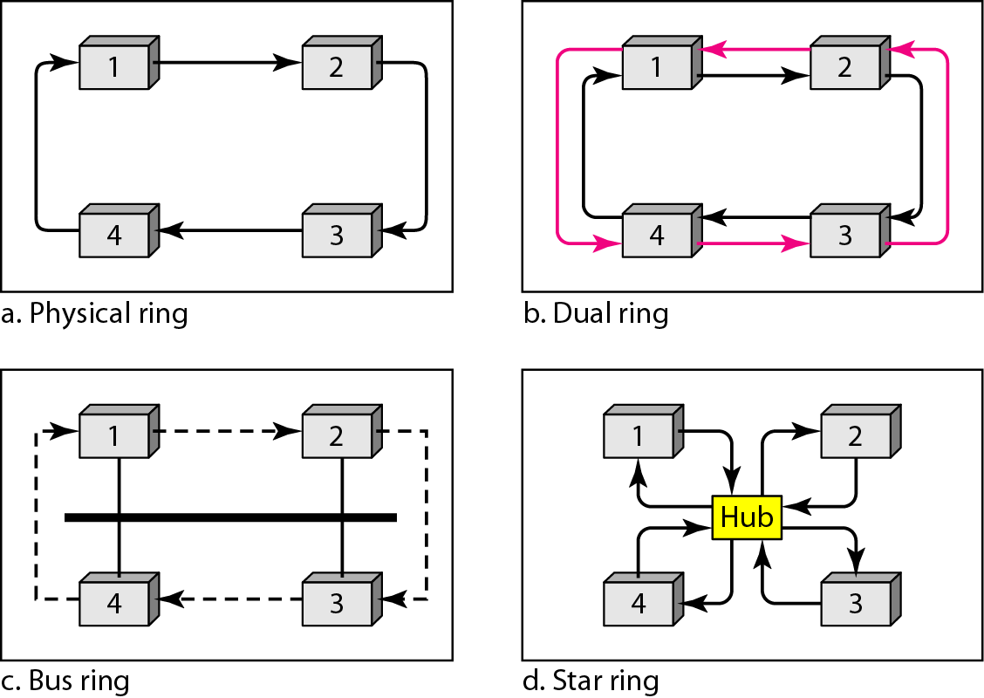
Logical ring and physical topology in token-passing access method
Figure 3 Logical ring and physical topology in token-passing access method

Slide 8
CHANNELIZATION
Channelization is a multiple-access method in which the available bandwidth of a link is shared in time, frequency, or through code, between different stations.
There are three channelization protocols.

Slide 9
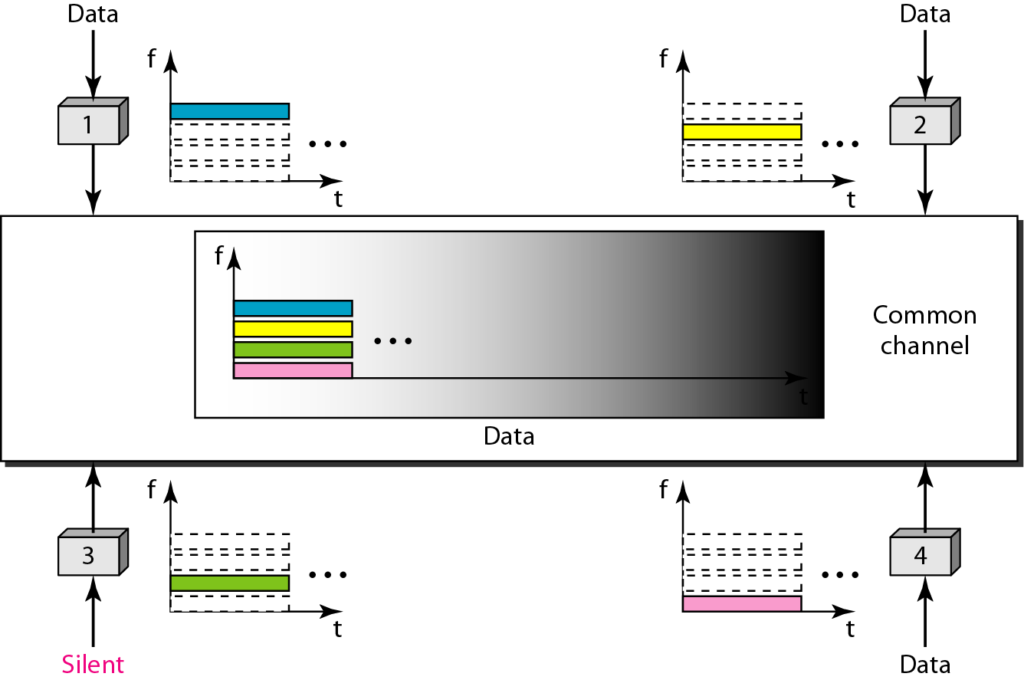
Frequency-division multiple access (FDMA)
Figure 4 Frequency-division multiple access (FDMA)

Slide 10
In FDMA, the available bandwidth of the common channel is divided into bands that are separated by guard bands.

Slide 11
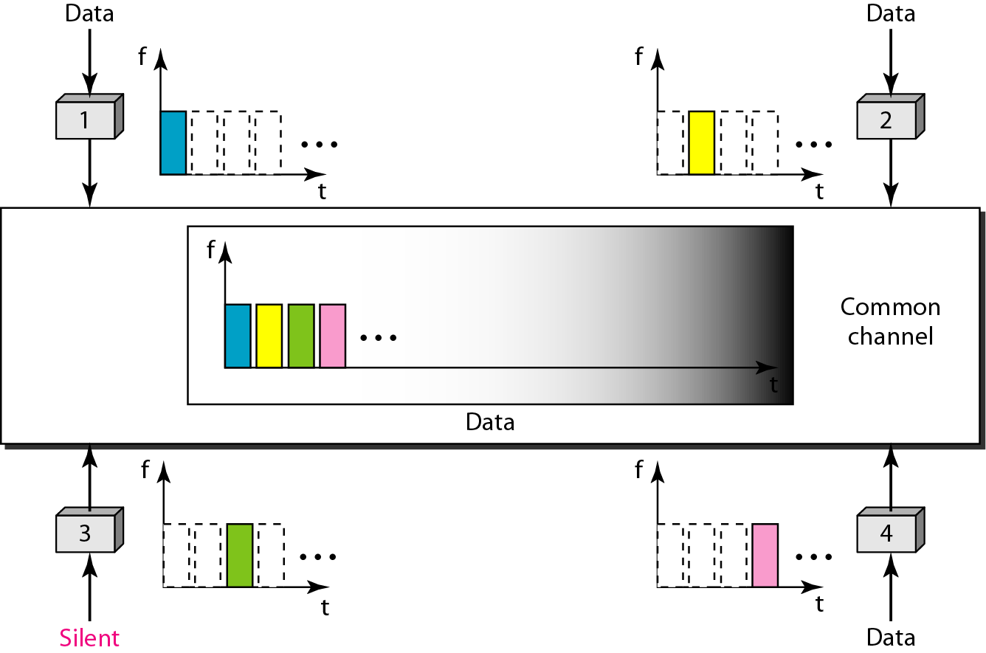
Time-division multiple access (TDMA)
Figure 5 Time-division multiple access (TDMA)

Slide 12
In TDMA, the bandwidth is just one channel that is timeshared between different stations.

Slide 13
In CDMA, one channel carries all transmissions simultaneously.

Slide 14
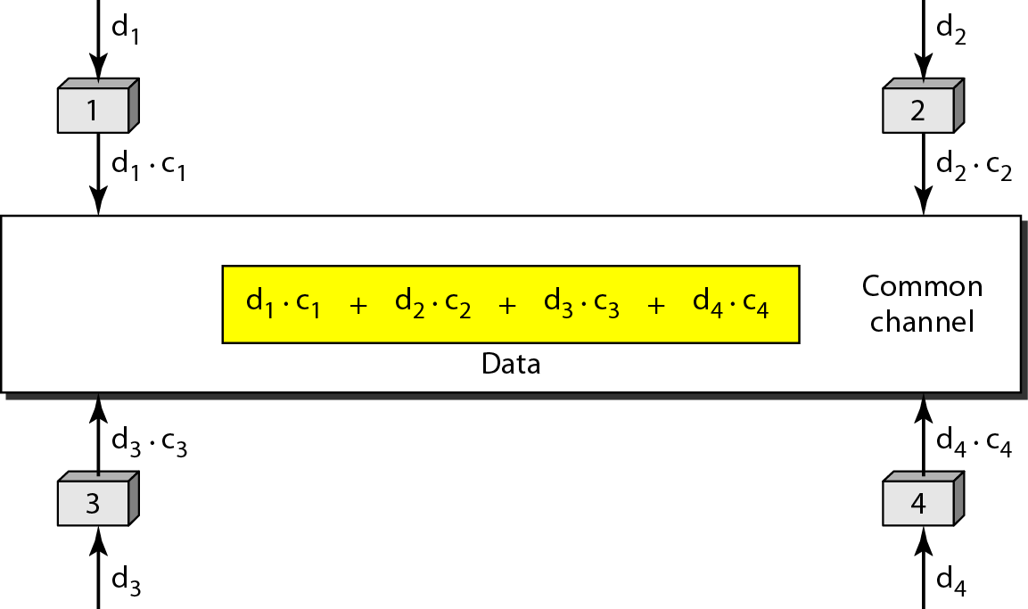
Simple idea of communication with
code
Figure 6 Simple idea of communication with code

Slide 15
Chip sequences
Figure. 7 Chip sequences

Slide 16
Data representation in CDMA
Figure 8 Data representation in CDMA

Slide 17
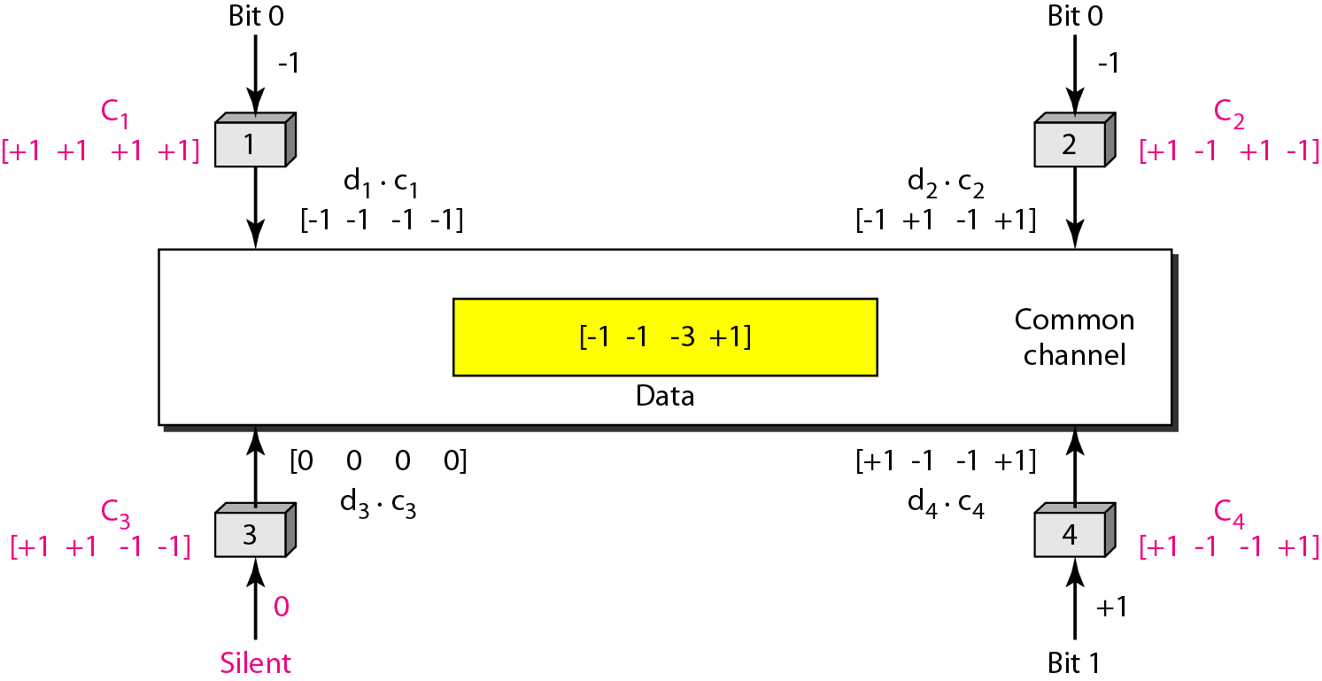
Sharing channel in CDMA
Figure 9 Sharing channel in CDMA

Slide 18
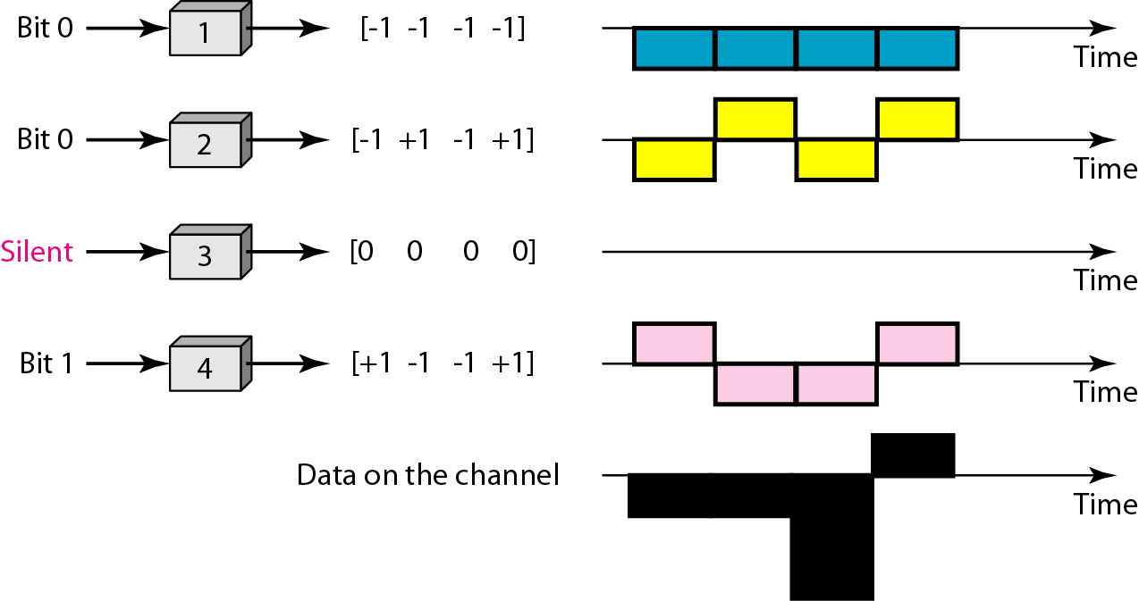
Digital signal created by four stations in CDMA
Figure 10 Digital signal created by four stations in CDMA

Slide 19
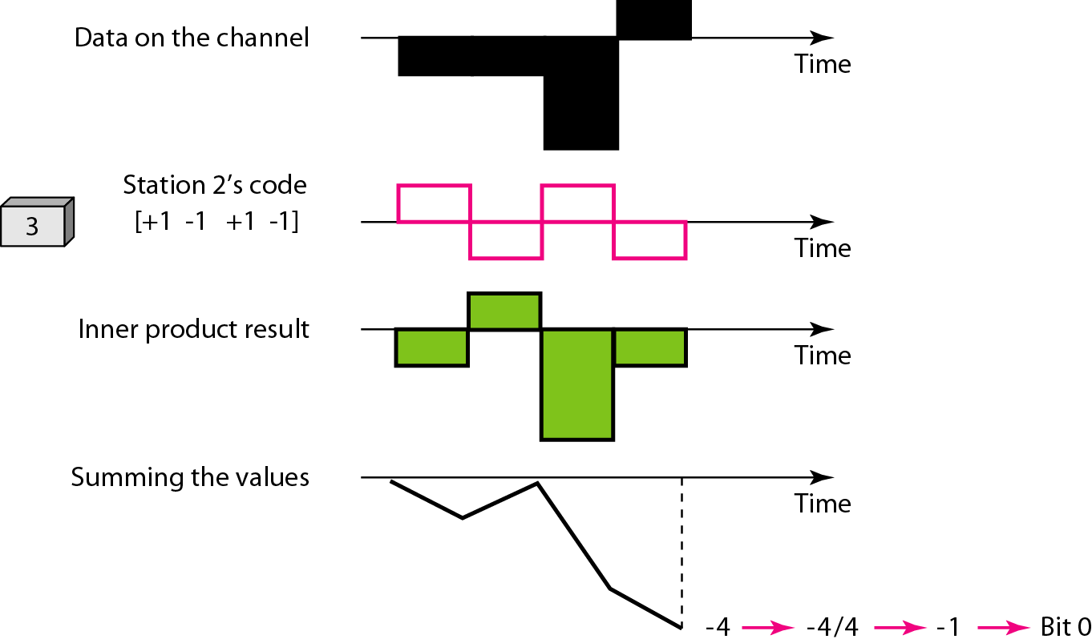
Decoding of the composite signal for one in CDMA
Figure 11 Decoding of the composite signal for one in CDMA

Slide 20
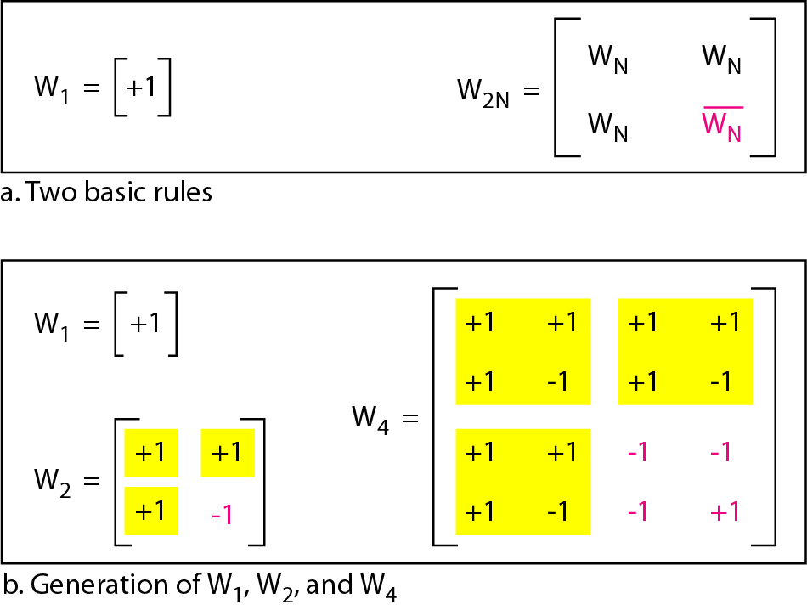
General rule and examples of creating Walsh tables
Figure 12 General rule and examples of creating Walsh tables

Slide 21
The number of sequences in a Walsh table needs to be N = 2^{m}.

Slide 22
Example
Find the chips for a network with
Two stations
Four stations
Solution
We can use the rows of W2 and W4 in Figure 12.29:
a. For a two-station network, we have [+1 +1] and [+1 −1].
b. For a four-station network we have [+1 +1 +1 +1], [+1 −1 +1 −1], [+1 +1 −1 −1], and [+1 −1 −1 +1].

Slide 23
Example
What is the number of sequences if we have 90 stations in our network?
Solution
The number of sequences needs to be 2^{m}. We need to choose m = 7 and N = 2⁷ or 128.
We can then use 90 of the sequences as the chips.

Slide 24
Example
Prove that a receiving station can get the data sent by a specific sender if it multiplies the entire data on the channel by the sender’s chip code and then divides it by the number of stations.
Solution
Let us prove this for the first station, using our previous four-station example. We can say that the data on the channel
D = (d1 ⋅ c1 + d2 ⋅ c2 + d3 ⋅ c3 + d4 ⋅ c4)
The receiver which wants to get the data sent by station 1 multiplies these data by c1.

Slide 25
Example (continued)
When we divide the result by N, we get d1 .

Slide 26
Practice Questions
https://examradar.com/multiple-access-mcq-data-communication-networking/
https://mcqslearn.com/cs/computer-networks/channelization-multiple-choice-questions.php
https://www.javatpoint.com/fdma-vs-tdma-vs-cdma
https://pinoybix.org/2017/07/mcq-in-network-layer-internet-protocol-forouzan.html
https://edurev.in/course/quiz/attempt/-1_Test-Ipv4--IP-Packet/0decdb37-7206-4824-afdd-d47013a5c4cd

Slide 27
Thank you

